Slide 1






US Road Accident Prediction
Notes:
Hello everyone, my name is Arnav Varyani, and alongside me is Dev. Today, we're excited to present our project on traffic accidents, a significant public issue in the United States.

Slide 2



Introduction
In 2022, US traffic accidents caused 42,795 deaths and 4.2 million injuries, spotlighting a critical public health issue.
The objective is to create a predictive model using the US Accidents dataset for identifying high-risk drivers and vehicles to inform interventions for reducing accidents
Notes:
In 2022, an alarming 42,795 lives were lost in traffic accidents.
Our project leverages the US Accidents Dataset to develop a predictive model.
This model aims to inform various strategies to reduce both the number and severity of these accidents.
Our primary goal is to identify drivers and vehicles at high risk, ultimately saving lives and reducing accident severity.

Slide 3


Dataset
1. This dataset covers 49 states in the USA, with 7.7 million accident records collected from Feb 2016 to Mar 2023
2. The data is sourced from various entities, such as transportation departments, law enforcement, cameras, and sensors
3. The dataset size is approximately 2.9GB, providing comprehensive traffic incident information
Notes:
Our dataset spans across 49 states in the USA and our records collected from February 2016 to March 2023.
It includes a vast array of data points, with about 7.7 million rows and 46 columns.
It was gathered from sources like transportation departments, law enforcement, cameras, and sensors, amounting to around 2.9 GB in size.

Slide 4



Methodology
Exploratory Data Analysis
Feature
Engineering
Model Selection & Evaluation
Data
Pre-processing
Use trained model to predict accidents
Notes:
Our methodology involved several critical steps, including data pre-processing, feature engineering, exploratory data analysis (EDA), and training five different models namely KNN, Naïve Bayes, Random Forest, Decision Trees and Logistic Regression for accident severity prediction.

Slide 5
Data pre-processing
We began by organizing the US Car accidents dataset.
2. This step involved cleaning text data, handling missing values, and formatting the data for analysis.
We utilized tools like NumPy, Pandas, Matplotlib, and Sci-kit learn for this process.
3. During our data pre-processing, we checked for null and unique values in each column, removing any columns that were not necessary for our analysis.
Notes:
We split the dataset into training and test sets.
By allocating 20% to 25% of the data for testing,
we were able to train our model on a substantial part of the data,
while keeping a significant portion for evaluating the model's performance on new, unseen data.

Slide 6
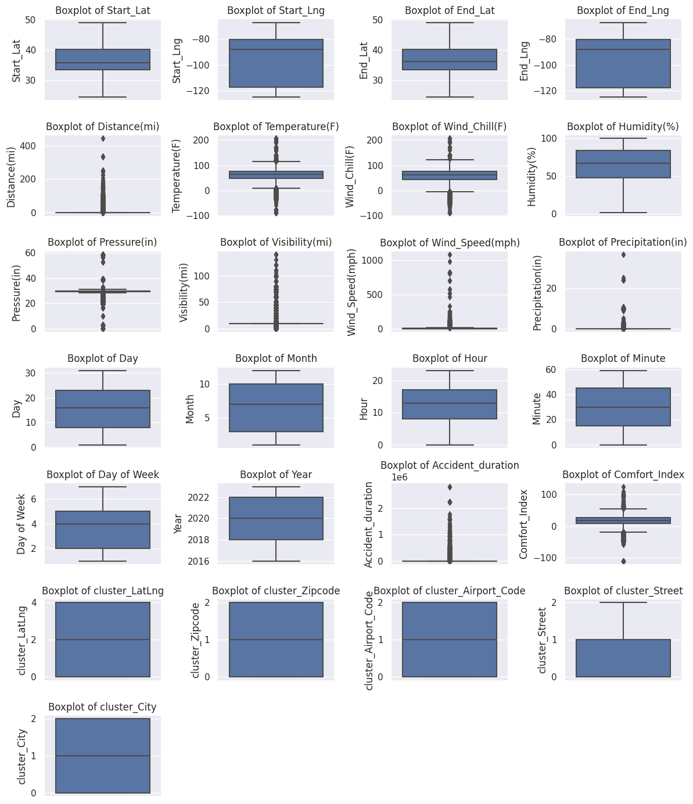
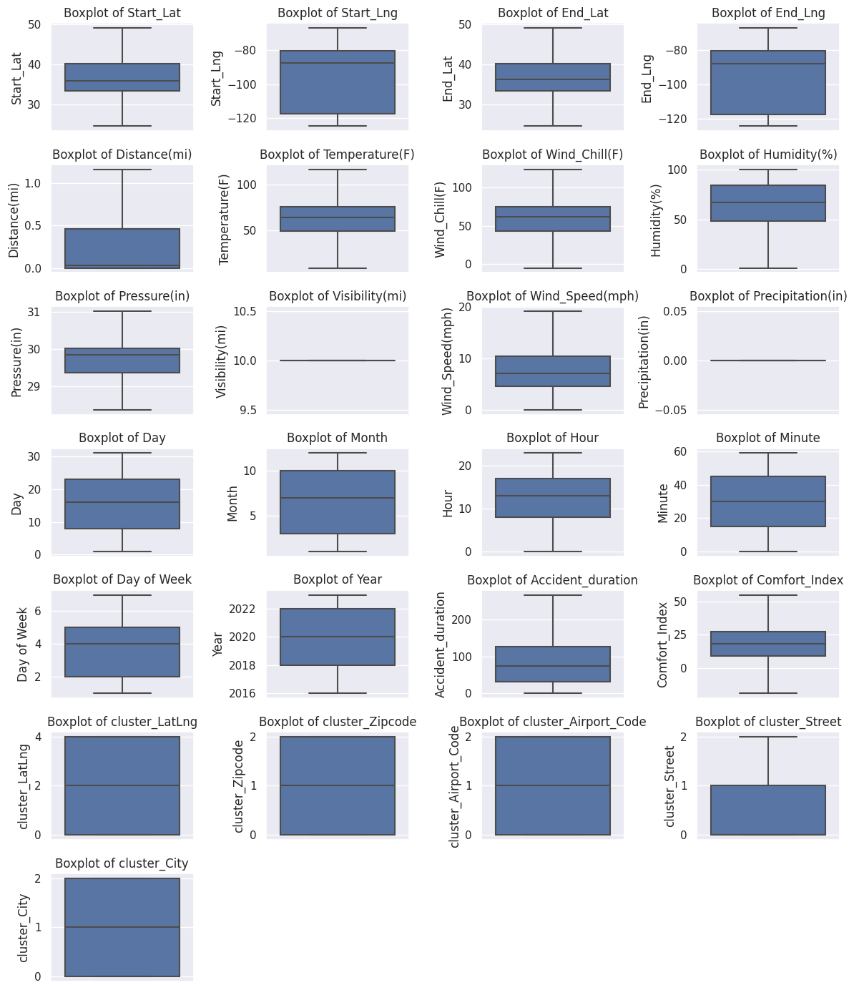
Outlier treatment
Notes:
We have removed null values as well as outlier treatment
We have removed outliers in our dataset particularly ones with extreme temperatures and wind speed

Slide 7
Exploratory
Data
Analysis

Slide 8

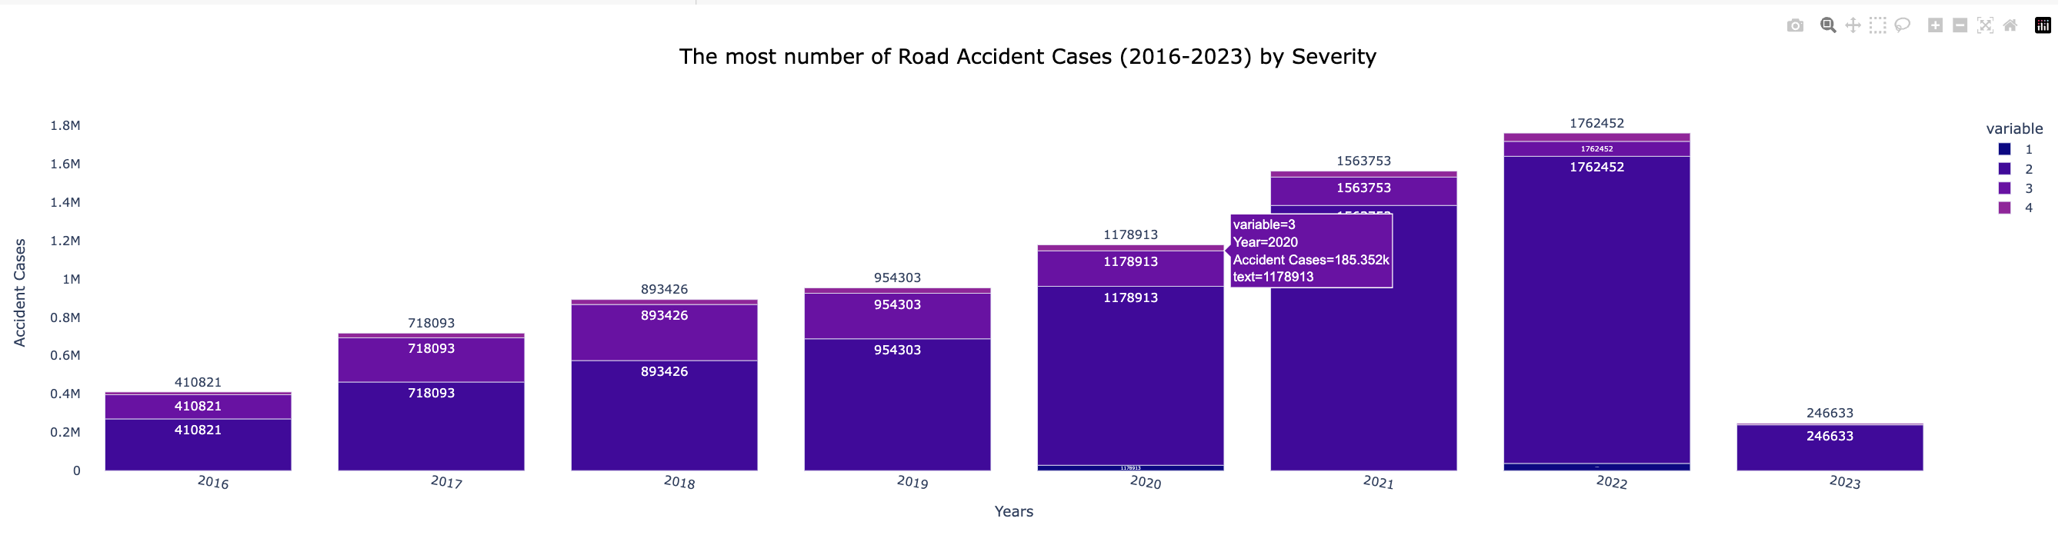
Number of accidents by severity
Notes:
We have used plotly.js to show all our visualisations and we made it interactive with this library and here the variables 1,2,3,4 represent the severity of the accident, being severity 1,2,3 and 4
Our exploratory data analysis revealed some intriguing trends.
For instance, this stacked barchart shows an increasing trend in road accident cases from 2016 to 2023. Not only are accidents increasing each year, but their severity also seems to be rising.

Slide 9
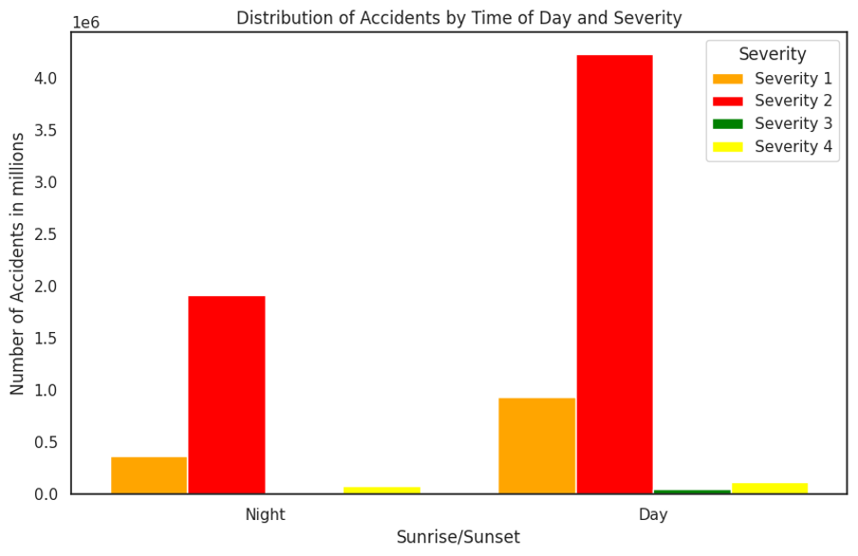
Distribution of Accidents by Time of Day & Severity
Notes:
In this as we can see it compares the number of accidents by time of day categorized by severity levels revealed that most accidents happen during the day.
Surprisingly, this time frame had a higher number of severe accidents, suggesting that increased visibility does not necessarily correlate with reduced accident severity.

Slide 10
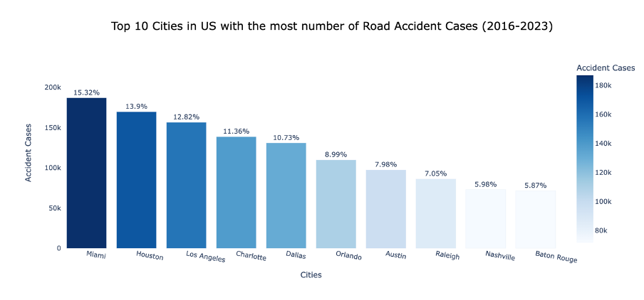
Most accidents as per state
Notes:
We also analyzed the distribution of road accident cases in the top 10 US cities sgmented by severity.
Cities like Miami, Houston, and Los Angeles stood out with the highest number of cases, Which indicates areas that might benefit from targeted safety improvements.

Slide 11
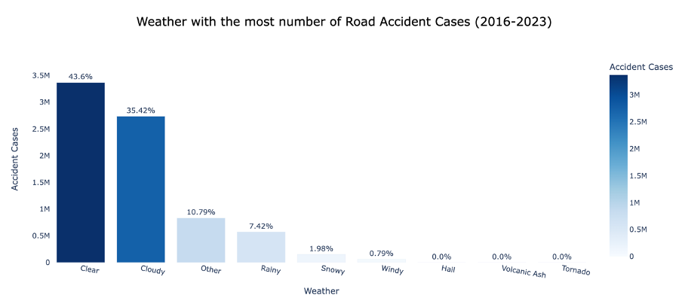
Most accidents as per weather
Notes:
Our analysis of road accidents against different weather conditions showed that clear and cloudy weather led to more accidents.
This might seem counterintuitive, but these conditions are more common, and drivers might be less cautious in seemingly favorable weather.

Slide 12
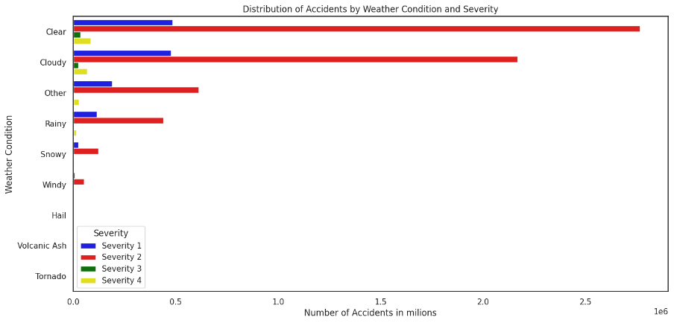
Distribution of Accidents by Weather conditions & severity
Notes:
In this we can see the severity of accidents compared by the weather conditions

Slide 13
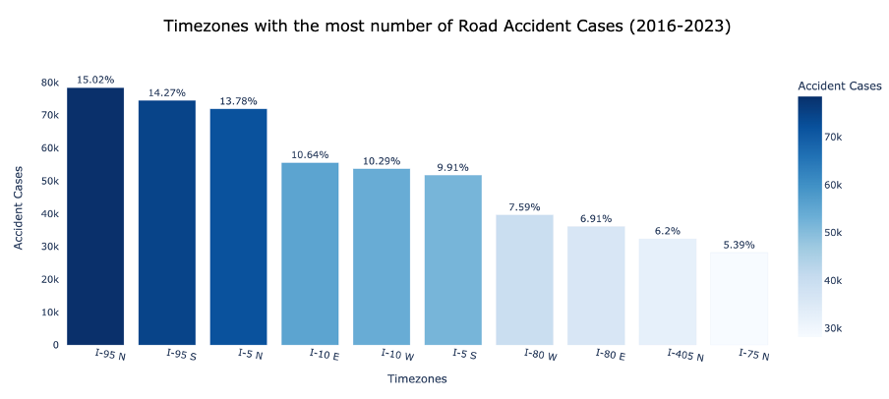
Most accidents as per zone
Notes:
We also examined the number of road accidents across various highway zones.
Certain zones, like Interstate 95 North, shown as I-95N showed a higher incidence of accidents, which can due to increased traffic volumes or problematic road sections.

Slide 14
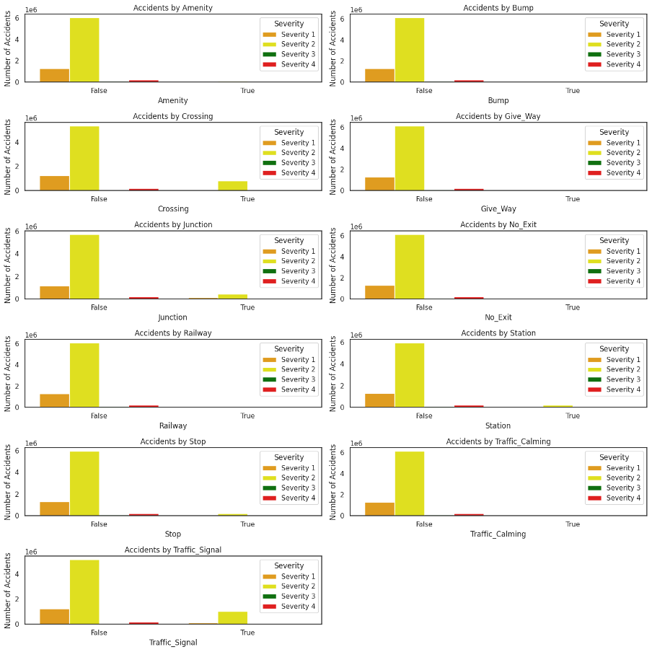
Distribution of Accidents by road features
Notes:
This data breaks down accident numbers by the presence of different road features, like amenities, bumps, crossings, and junctions.
Most features correlated with fewer severe accidents, indicating their potential role in reducing accident severity.

Slide 15
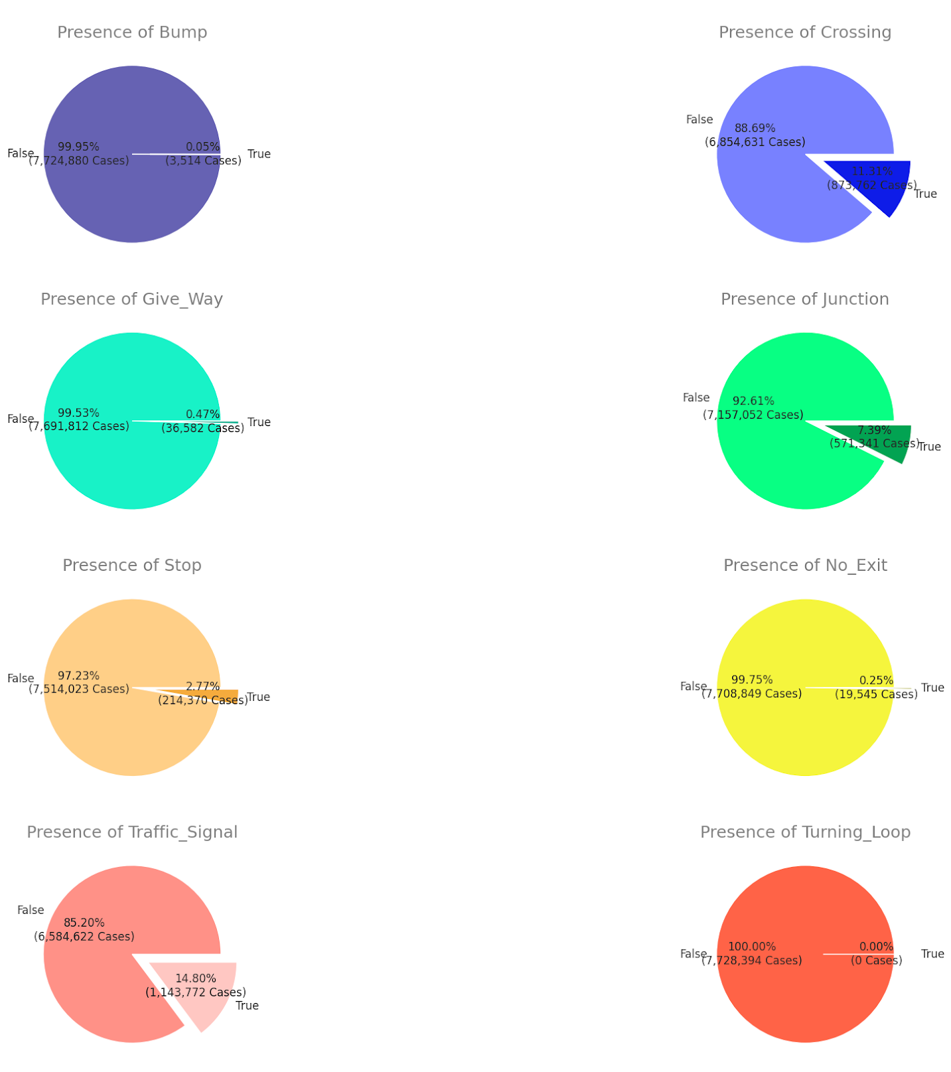
Percentage of accidents in presence of road features
Notes:
Finally, we can see in these pie charts show the percentage of accidents occurring near specific road features.
One observation we can make is that most accidents happened in areas without bumps, junctions, or traffic calming measures meaning that even in the presence of this accidents still occurred.
The maximum accidents being in the presence traffic signals means there is scope for improvement.

Slide 16
Feature
Engineering

Slide 17
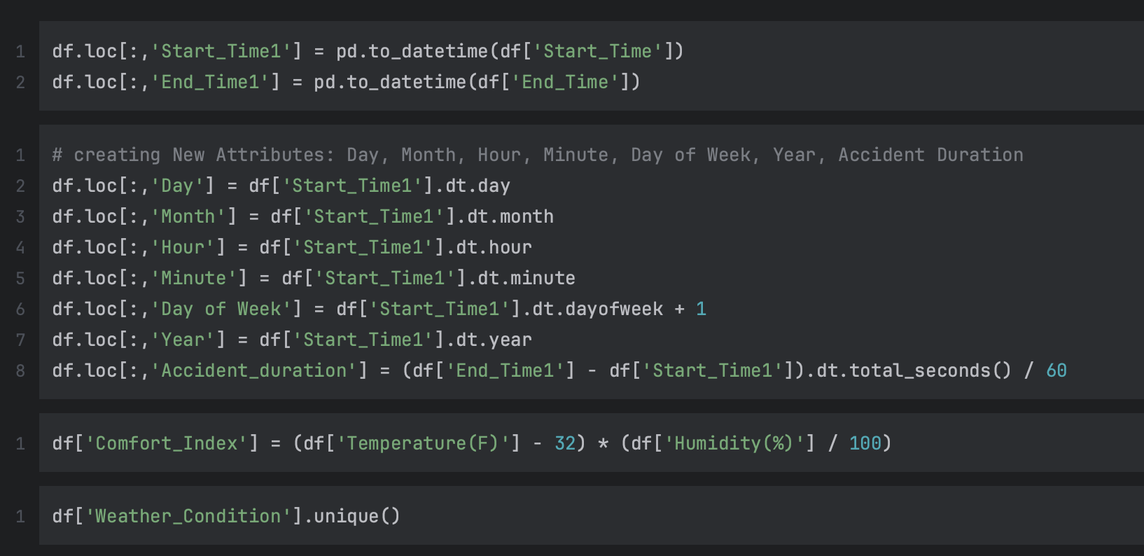
Feature engineering
1. Created new attributes like day, month, hour, minute, day of the week, year, accident duration, comfort index from the start time & end time
2. Our target variable was ‘Severity’
3. Feature scaling using ‘Standard Scaler’
Notes:
We created new attributes like day, month, hour, minute, day of the week, year which we extract from our start time
and accident duration from end time – start time in seconds divided by 60 which gives it to us in minutes
We then performed label encoding on two categorical columns 'source' and
'weather bins’ – and to make the these we made a dictionary where we assigned key value pairs based on the weather types and similar conditions
Additionally, we applied boolean mapping, assigning 0 for false and 1 for true values in boolean variables.
We introduced a 'comfort index’ where
Comfort index = temperature – 32 * humidity / 100
derived from weather conditions and time of day, to see how comfortable it will be for the driver to drive
Our target variable is the severity column which was crucial for our supervised learning approach. Now dev will takeover

Slide 18
K-Means Clustering
Employed K-Means for geospatial data
2. Pre-processed data for clustering
3. Normalized 'Start_Lat' and 'Start_Lng’, Cities, Airport zipcode
4. Determined optimal cluster count using the Elbow Method

Slide 19
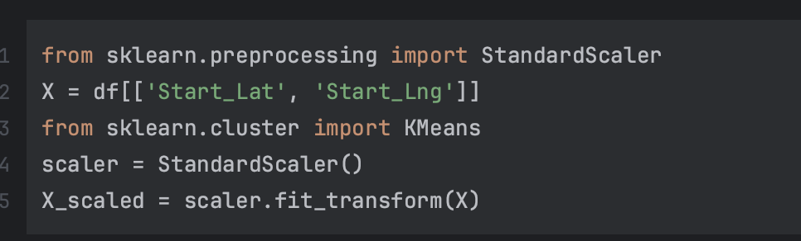
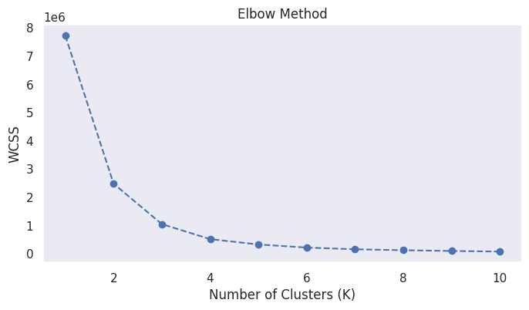
K-Means using Elbow Method
Notes:
Wccs rate of decrease,

Slide 20
Results & Analysis

Slide 21
Machine Learning Models
1. KNN Algorithm
2. Naïve Bayes
3. Random Forest and Decision Tree
4. Logistic Regression

Slide 22
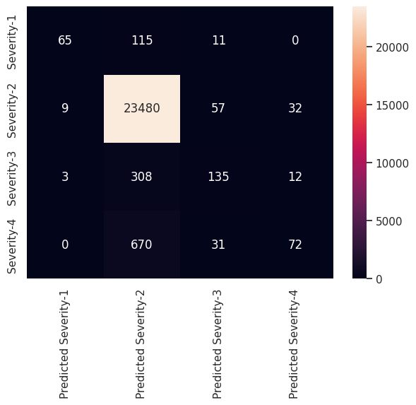
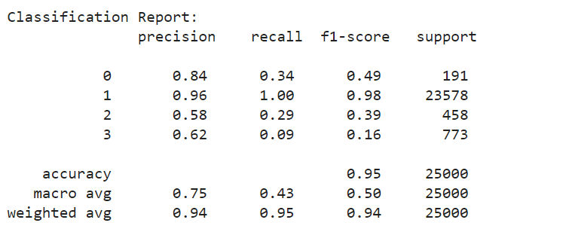


Random Forest
0 – Severity 1
1 – Severity 2
2 – Severity 3
3 – Severity 4
Training Accuracy: 0.99936
Test Accuracy: 0.95008

Slide 23
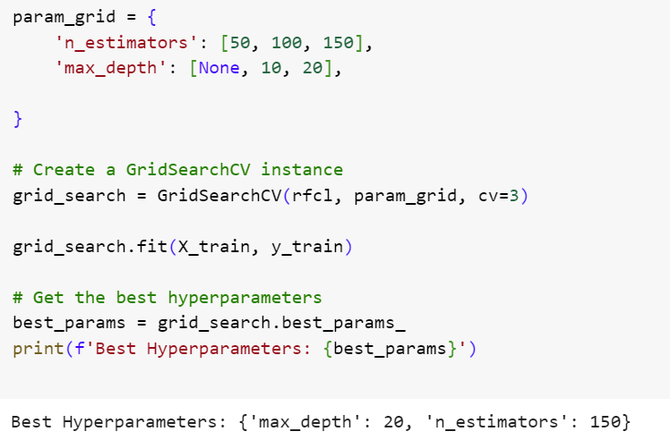

Random Forest hyperparameter tuning
Test Accuracy: 0.95068
Test Accuracy: 0.95068

Slide 24
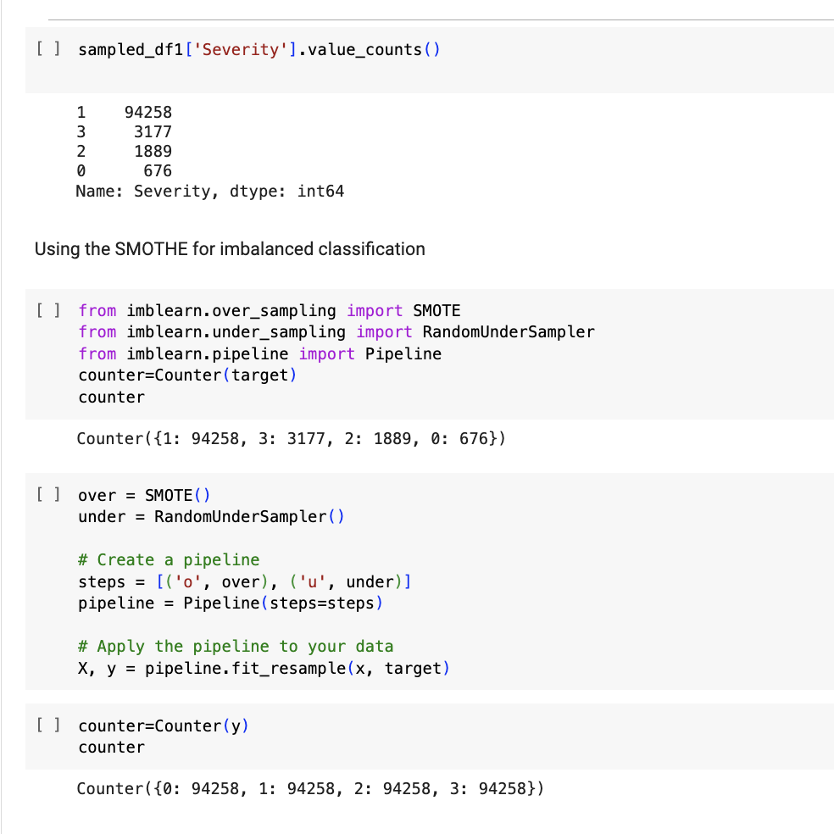
Over Sampling using SMOTE
Test Accuracy: 0.95068

Slide 25
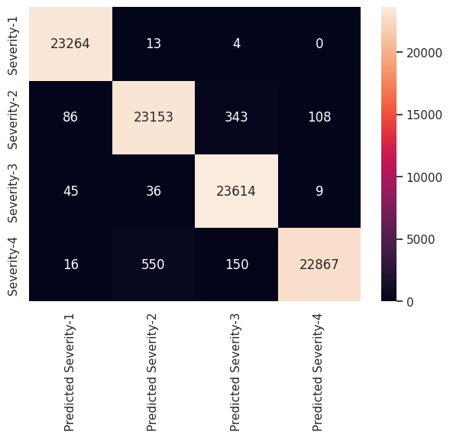
Random Forest after Oversampling
Training Accuracy: 0.9999045173884444
Test Accuracy: 0.9855715164760551

Slide 26
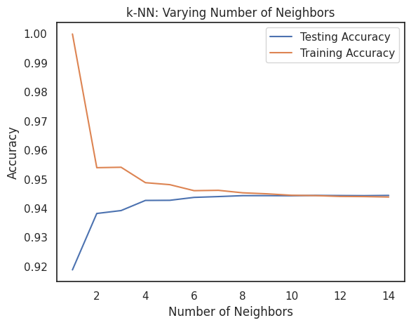
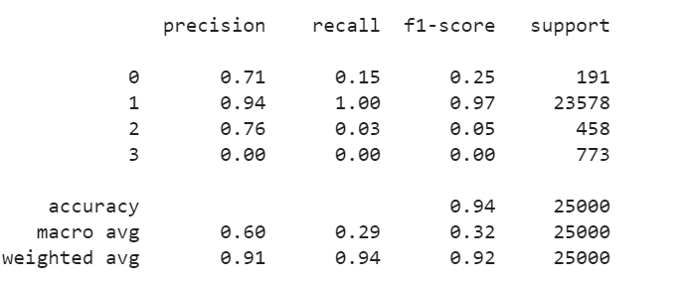
KNN algorithm
[K-Nearest Neighbors (KNN)] Accuracy score: 0.944. [K-Nearest Neighbors (KNN)] Score: 0.944.
0 – Severity 1
1 – Severity 2
2 – Severity 3
3 – Severity 4

Slide 27
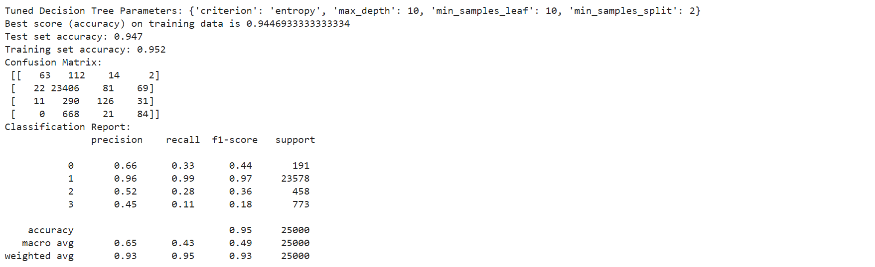
Decision Tree Classifier
Notes:
Decision Trees efficiently segment our accident data into branches, representing different severity levels. They excel in interpretability, showcasing clear paths of decisions based on accident characteristics. However, they can be prone to overfitting, especially with complex or noisy data which happened in our study as well.
criterion: The function to measure the quality of a split. It can take values 'entropy' or 'gini'. 'Entropy' uses the information gain for the split, and 'gini' uses the Gini impurity. This parameter helps define the impurity measure used in the decision tree.
max_depth: The maximum depth of the tree. It determines the maximum number of levels in the decision tree. Specifying None allows nodes to expand until they contain fewer than min_samples_split samples.
min_samples_split: The minimum number of samples required to split an internal node. This parameter controls the minimum size of a node to be split further.
min_samples_leaf: The minimum number of samples required to be at a leaf node. This parameter sets the minimum size of terminal nodes (leaves) and is useful for controlling the depth of the tree.
Your parameter grid explores various

Slide 28
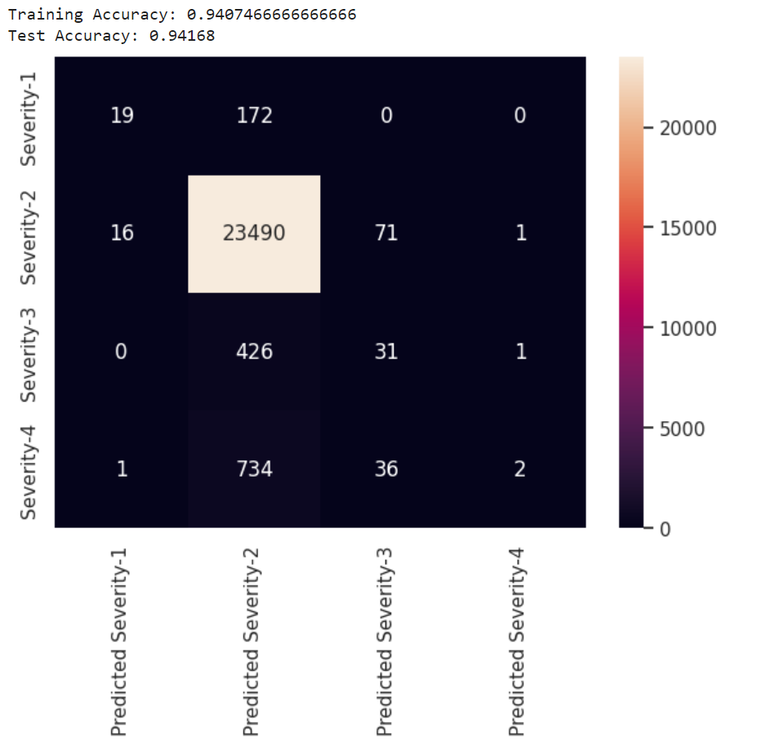
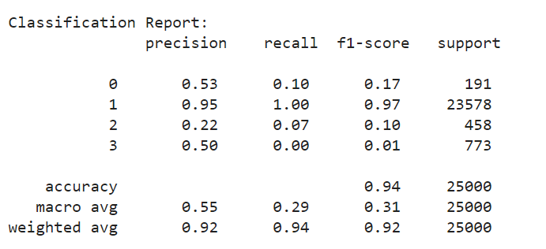
Logistic Regression
0 – Severity 1
1 – Severity 2
2 – Severity 3
3 – Severity 4
Training Accuracy: 0.9407466666666666
Test Accuracy: 0.94168
Notes:
Logistic Regression: In predicting accident severity, the Logistic Regression model demonstrated exceptional performance, particularly after meticulous feature engineering. This model is adept at handling multiple classes, making it ideal for categorizing accidents into four distinct severity types. It works by predicting the probability of each severity level for a given accident, utilizing a logistic function. The model's ability to provide clear, interpretable results, coupled with its robustness in multi-class classification, made it the best model in our by having the Accuracy score when compared with other models.

Slide 29
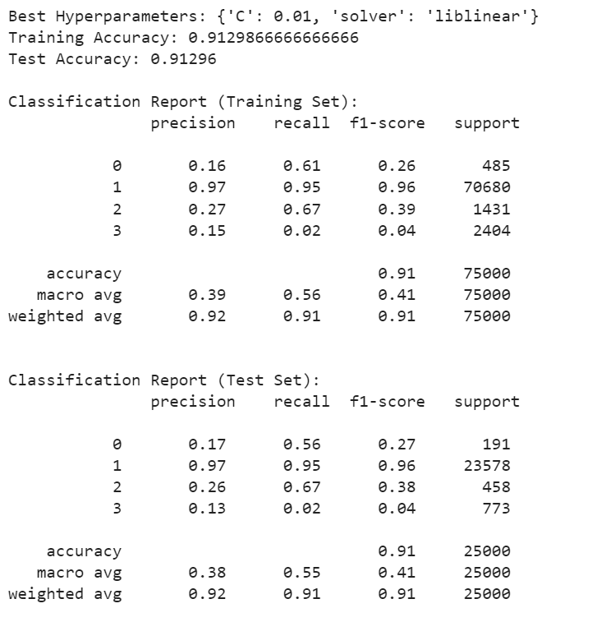
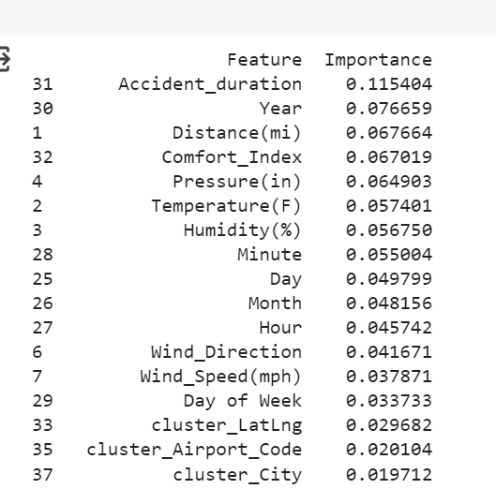
Logistics: Regression: Feature Importance
Notes:
param_grid = {,
'C': [0.01, 0.1, 1, 10, 100], # Regularization parameter
'solver': ['newton-cg', 'lbfgs', 'liblinear'], # Different algorithms
'C': [0.01, 0.1, 1, 10, 100]:
C is the inverse of the regularization strength. Regularization is a technique used in machine learning to prevent overfitting by penalizing large coefficients in the model.
The values provided (0.01, 0.1, 1, 10, 100) represent a range from very strong regularization (0.01) to very weak regularization (100).
solver': ['newton-cg', 'lbfgs', 'liblinear’]:
set to 'balanced' since the data is not balanced class_weight

Slide 30
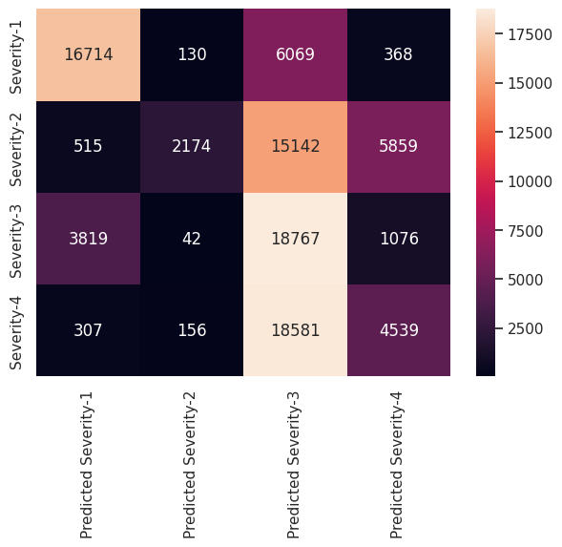
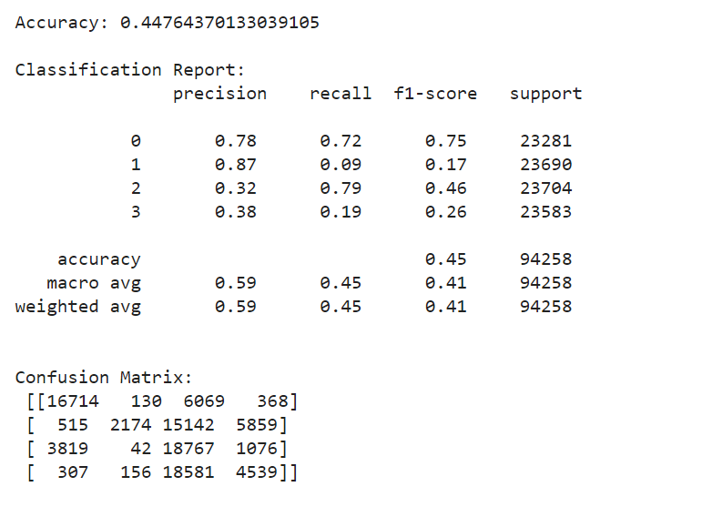
Naïve Bayes
0 – Severity 1
1 – Severity 2
2 – Severity 3
3 – Severity 4
Notes:
Given the high Dimensionality of the Data and the simplicity and it’s efficiency, we decided to start with Naive Bayes model as our initial Classifier. They were built for multi-class classification problems which suits out use case to predict 4 types of Accident severity. They also operate on the principle of conditional probability, assuming independence between features, which simplest the computation in multiclass scenarios. This makes Naive Bayes a suitable choice for our problem, offering a good balance between the predictive performance and computational efficiency in handling multi-classes

Slide 31

Conclusion
1. Logistic Regression, before oversampling, emerged as the most accurate model for predicting accident severity based on our evaluation metrics.
2. Our analysis revealed critical factors influencing accident severity, offering a deeper understanding of road accidents' dynamics.
3. Varying model performance highlighted challenges with imbalanced data, presenting opportunities for future research with advanced algorithms and real-time data analysis.
4. This project showcases the potential of machine learning in public safety, laying the groundwork for data-driven decisions that prioritize human safety on our roads.

Slide 32

References
[1] Class notes, Jupyter notebooks from Professor Handan Liu
[2] Pandas Documentation: Pandas
[3] Seaborn Visualization Library: Seaborn
[4] Scikit-learn for Machine Learning: Scikit-learn
[5] US Accidents Dataset: US Accidents: (2016-2023)

